Slide 1



topic:
C-SEP perform better than info. Gain and Gini in certain case
ROOM 2
Programming for Data Science
Lecturer: Mr. CHANN SOPHAL

Slide 2


Member Name:
Yit Vathana
Hak Kimhong
Lun Tola
Nor Phanit
Seng Vathanak
6. Phun Sreypich
7. Koythol Amrint
8. Taing Kimmeng
9. Mao Kimlang
10. Set Sophy

Slide 3

Introduction
How It work
Entropy, information Gain, Gini index
How It Use
Table Of Content
why C-SEP is better than Gini index and informjation Gain?
About C-SEP and Concept of it
Conclusion

Slide 4
INTRODUCTION
Decision tree is a non-parametric supervised learning algorithm, which is utilized for both classification and regression tasks. It has a hierarchical, tree structure, which consists of a root node, branches, internal nodes and leaf nodes. It can be used for both regression and classification tasks. They are easy to understand, interpret, and implement, making them an ideal choice for beginners in the field of machine learning.

Slide 5
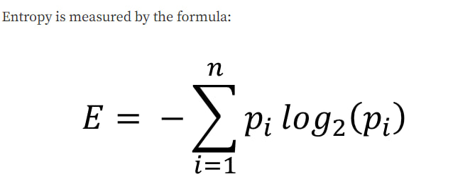
2. What is Entropy, Information gain and Gini index?
In decision tree, entropy is a measure of impurity or disorder in a set of examples. It is used as a criterion for selecting the best split at each node of the decision tree during the learning process.
The formula of Entropy method
where:
p(i) is the probability of class label i
log2(p(i)) is the logarithm of p(i) to base 2

Slide 6
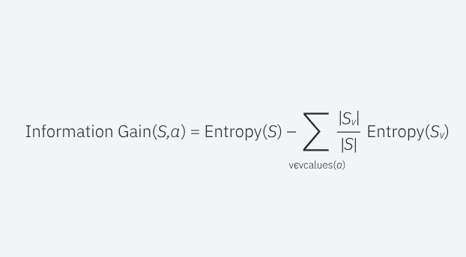
Information Gain: Information gain measures the reduction in entropy achieved by partitioning the data based on a specific attribute. It calculates the difference between the entropy of the original set and the weighted average entropy of the resulting subsets.
Where
a represents a specific attribute or class label
Entropy(S) is the entropy of originaldataset, S
|Sv| represents the number of instances in subset Sv, which is the subset of S for a specific attribute value v
|S| represents the total number of instances in the dataset S.
Entropy(Sv) is the entropy of subset Sv, calculated based on the class distribution within that subset.

Slide 7
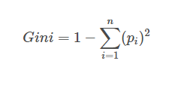
Gini Index: The Gini index is another measure of impurity used in decision tree algorithms. It quantifies the probability of misclassifying a randomly selected example if it were randomly labeled according to the distribution of class labels in a subset. The formula of the Gini Index is as follows:
where
pi is the probability of an object being classified to a particular class.

Slide 8
What is C-SEP?
WHAT IS C-SEP?
Conditional Symmetrical Entropy Partitioning (C-SEP) is an attribute selection method used in decision trees. It is based on the idea of entropy, which measures the uncertainty of a random variable. In the context of decision trees, entropy is used to measure the impurity of a node. A node is impure if the data points in the node are not all classified into the same category.

Slide 9
Concept
WHATCONISCC C-SEP?
The concept of C-SEP follow as:
The entropy of an attribute measures the uncertainty about the attribute.
The conditional symmetrical entropy of an attribute measures the uncertainty about the attribute, given the class label.
The attribute with the highest conditional symmetrical entropy is the one that is most likely to help to reduce the impurity of the node.
C-SEP partitions the data in the node based on the attribute with the highest conditional symmetrical entropy.

Slide 10
How C-SEP works?
HOW DOES C-SEP WORKS?
C-SEP works by partitioning the data in a node based on the attribute that has the highest conditional symmetrical entropy. The conditional symmetrical entropy of an attribute is the entropy of the attribute, conditional on the class label. In other words, it measures how much uncertainty there is about the attribute, given the class label.
The attribute with the highest conditional symmetrical entropy is the one that is most likely to help to reduce the impurity of the node. Therefore, C-SEP partitions the data in the node based on this attribute. This process is repeated recursively until all of the nodes in the decision tree are pure.

Slide 11
C-SEP formula
C-SEP works by first calculating the conditional symmetrical entropy of each attribute in the dataset. The conditional symmetrical entropy of an attribute is calculated using the following formula:
C-SEP(A|Y) = -∑ p(y)*∑ p(a|y)*log2(p(a|y))
Where:
A is the attribute
Y is the class label
p(y) is the probability of variable Y
p(a|y) is the conditional probability of variable A taking on a particular value given that variable Y
log2(p(a|y)) is the logarithm of p(a|y)

Slide 12
APPLCATION OFBENIFIT C-SEP?
How C-SEP use?
CSEP can be used in a variety of applications, including:
Credit scoring: C-SEP can be used to assess the creditworthiness of potential borrowers.
Medical diagnosis: C-SEP can be used to diagnose diseases.
Fraud detection: C-SEP can be used to detect fraudulent transactions.
Customer segmentation: C-SEP can be used to segment customers into different groups.

Slide 13
Why does C-SEP perform better than Gini index and Information Gain?
C-SEP is a more effective measure of impurity than Gini index and information gain because it takes into account the correlation between attributes. Gini index and information gain do not take into account the correlation between attributes, which can lead to suboptimal splits.
Here are some additional reasons why C-SEP may perform better than Gini index and information gain:
C-SEP is more robust to noise in the data.
C-SEP is less sensitive to the order of the attributes.
C-SEP can be used to deal with continuous attributes.

Slide 14
Conclusion
Conditional Symmetrical Entropy Partitioning (C-SEP) is a simple and efficient attribute selection method that can be used in a variety of decision tree learning tasks. C-SEP has several advantages over other attribute selection methods, including its simplicity, efficiency, and effectiveness. However, C-SEP also has some disadvantages, such as its sensitivity to the order of the attributes. Overall, C-SEP is a powerful tool that can be used to improve the performance of decision trees.

Slide 15
THANK YOU

